Slide 1
CS 4530: Fundamentals of Software Engineering
Module 16A: Dependency Management
Adeel Bhutta and Mitch Wand (with material by Donald Pinckney)
Khoury College of Computer Sciences
© 2025, released under CC BY-SA

Slide 2
Learning Objectives for this Module
By the end of this module, you should be able to:
Explain why you need dependencies
Explain the major risks of dependencies
Explain the principles of semantic versioning
Explain what a package manager does
Understand that different package managers may solve dependencies differently

Slide 3
Software isn't written in a vacuum
Writing a JS app?
you depend on: React, 100s of small JS packages, Node, V8, …
Writing ML code in Python?
You depend on: PyTorch, Numpy, CUDA, C libraries, compilers, …
And so on for nearly all software

Slide 4
Our context:
You are writing an application in JS/TS
You need some services
Is there a dependency you can use, or should you build your own?

Slide 5
Risks of Dependencies
You are reliant on the designer's choices
(but: they may have done a better job than you would)
Security risks
Upstream risks (transitive dependencies)
May need multiple copies of some dependencies
How to keep them all up to date??

Slide 6
Dependency Management Isn't Easy
Too many dependencies to manage manually
Often 100+ for JavaScript projects when considering transitive dependencies
Too frequent dependency updates to apply manually
Even though they may be very important, e.g. critical security patches!
Dependency updates can’t be done in isolation: you may have to update other dependencies to match

Slide 7
We can control the direct dependencies, but not the transitive dependencies
We declare our immediate dependencies in a manifest: eg package.json
But we don't/can't control our dependencies' dependencies

Slide 8
What the *#*!?
$ npm install
npm WARN deprecated inflight@1.0.6: This module is not supported, and leaks memory. Do not use it. Check out lru-cache if you want a good and tested way to coalesce async requests by a key value, which is much more comprehensive and powerful.
npm WARN deprecated @humanwhocodes/config-array@0.13.0: Use @eslint/config-array instead
npm WARN deprecated rimraf@3.0.2: Rimraf versions prior to v4 are no longer supported
npm WARN deprecated glob@7.2.3: Glob versions prior to v9 are no longer supported
npm WARN deprecated glob@7.2.3: Glob versions prior to v9 are no longer supported
npm WARN deprecated glob@7.2.3: Glob versions prior to v9 are no longer supported
npm WARN deprecated glob@7.2.3: Glob versions prior to v9 are no longer supported
npm WARN deprecated glob@7.2.3: Glob versions prior to v9 are no longer supported
npm WARN deprecated @humanwhocodes/object-schema@2.0.3: Use @eslint/object-schema instead
npm WARN deprecated eslint@8.57.1: This version is no longer supported. Please see https://eslint.org/version-support for other options.
added 750 packages, and audited 751 packages in 1m

Slide 9
Package Managers Manage the Transitive Dependencies
NPM: 3 million+ packages
Complex graph of dependencies
20TB+ of package code
Fairly rich dependency specification language

Slide 10

Package Managers Manage the Transitive Dependencies
Install Request
"glob": ">=7.2.0"
"minimatch": ">=3.1.0"
@babel/cli
Package Manager
3.1.0
3.1.2
3.2.0
glob
v7.2.3
minimatch
???
Install Packages
minimatch
v3.1.0

Slide 11
What Can Go Wrong?
Dependency solving can fail
Conflicting constraints
Weaknesses in solving algorithms (old Pip, current NPM)
Install Request
Package Manager
Install Packages

Slide 12
What Can Go Wrong?
Dependency solving can fail
Conflicting constraints
Weaknesses in solving algorithms (old Pip, current NPM)
Dependency solutions can induce code failures
Build failures, runtime crashes, runtime bugs, etc.
Install Request
Package Manager
Install Packages

Slide 13
What Can Go Wrong?
Dependency solving can fail
Conflicting constraints
Weaknesses in solving algorithms (old Pip, current NPM)
Dependency solutions can induce code failures
Build failures, runtime crashes, runtime bugs, etc.
Low-quality dependency solutions
Security vulnerabilities
Large code size
Old versions of packages
Install Request
Package Manager
Install Packages

Slide 14
Semantic Versioning Can Help Keep Track of Breaking Changes
Given a version number MAJOR.MINOR.PATCH, increment the:
MAJOR version when you make incompatible API changes
MINOR version when you add functionality in a backward compatible manner
PATCH version when you make backward compatible bug fixes
Additional labels for pre-release and build metadata are available as extensions to the MAJOR.MINOR.PATCH format.
https://semver.org/

Slide 15
Semantic Versioning takes effort
"It’s hard to follow semantic versioning—it takes significant effort to make backward-compatible changes, backward-compatible bug fixes, and to backport security patches to old release numbers. However, following semantic versioning is the best way to spread joy to your downstream users."
https://semver.org/
Notes:
Semantic Versioning sounds good, but really doing it right takes effort

Slide 16
Characterizing Updates
Semver Increment
Security Effect
1.0.0
1.0.1
No Effect
Bug (Patch)
⚠️
⚠️
1.0.0
1.1.0
Minor
⚠️
Intro Vuln
1.0.0
2.0.0
Major
⚠️
Patch Vuln

Slide 17
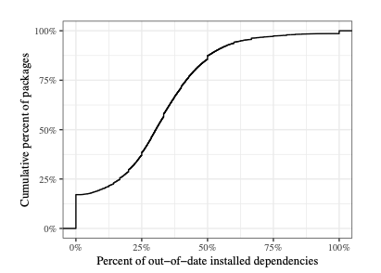
Most Packages Have Out-of-Date Dependencies

Slide 18
Most Packages Have Out-of-Date Dependencies
2
50% of packages have 31% or more of their dependencies out-of-date
17% of packages have fully up-to-date dependencies

Slide 19
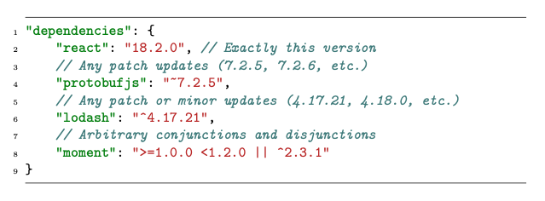
Semantic Versioning starts with your package.json
Notes:
Note the tilde on line 4, vs the caret on line 6.

Slide 20
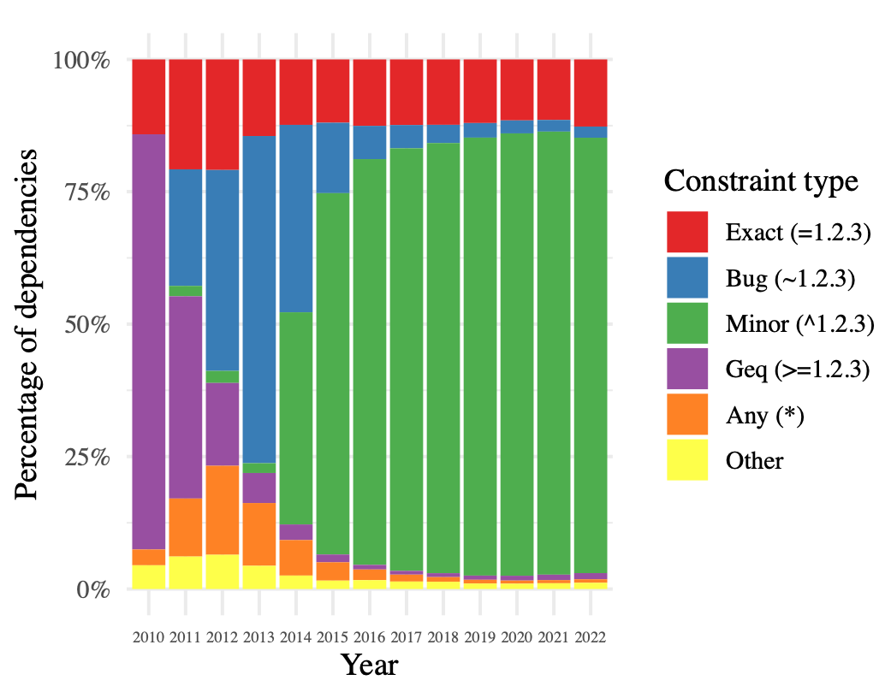
Developers Rarely Distinguish Bug vs. Minor Updates
Most constraints are either exact or minor-flexible

Slide 21
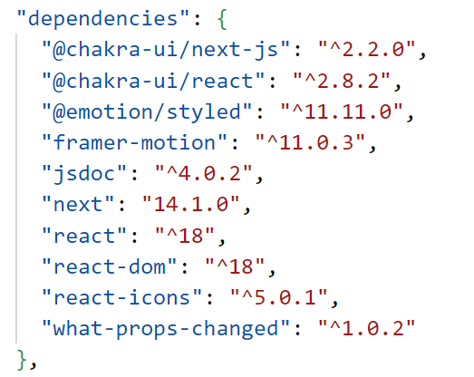
Probably because npm --save defaults to "^"

Slide 22
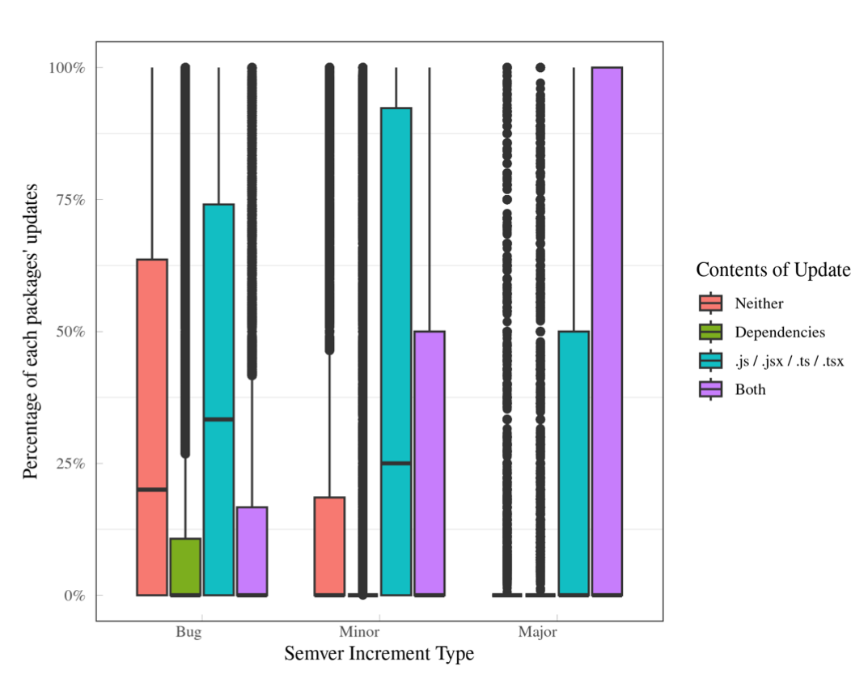
But even minor updates may require updating the client code
Bug updates may change NO JS code
Major / minor updates usually change code (+ dependencies)

Slide 23
Implications For Developers & Researchers
Consider using ~ constraints (bug updates) instead of ^ (bug + minor updates)
At the cost of technical lag
And forcing the technical lag on clients
Alternatively, allow developers to specify preferences outside of constraints
what would that even mean? 🤔

Slide 24

What is dependency solving?
"dependencies": {
"commander": "^2.8.1”,
"convert-source-map": "^1.1.0",
"fs-readdir-recursive": "^1.1.0",
"glob": "^7.0.0",
"lodash": "^4.17.10",
"mkdirp": "^0.5.1",
"output-file-sync": "^2.0.0",
"slash": "^2.0.0",
"source-map": "^0.5.0”
}
NPM
...

Slide 25
Consider the solution space
"dependencies": {
"commander": "^2.8.1”,
"convert-source-map": "^1.1.0",
"fs-readdir-recursive": "^1.1.0",
"glob": "^7.0.0",
"lodash": "^4.17.10",
"mkdirp": "^0.5.1",
"output-file-sync": "^2.0.0",
"slash": "^2.0.0",
"source-map": "^0.5.0”
}
{"commander" @ "^2.8.1”,
"convert-source-map": @ "^1.1.1",
...
}
{"commander" @ "^2.8.1”,
"convert-source-map": @ "^2.1.1",
...
}
25
Notes:
Each dot represents a possible choice of the versions of these 9 programs. Some are acceptable, some are not.

Slide 26
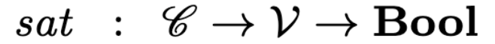
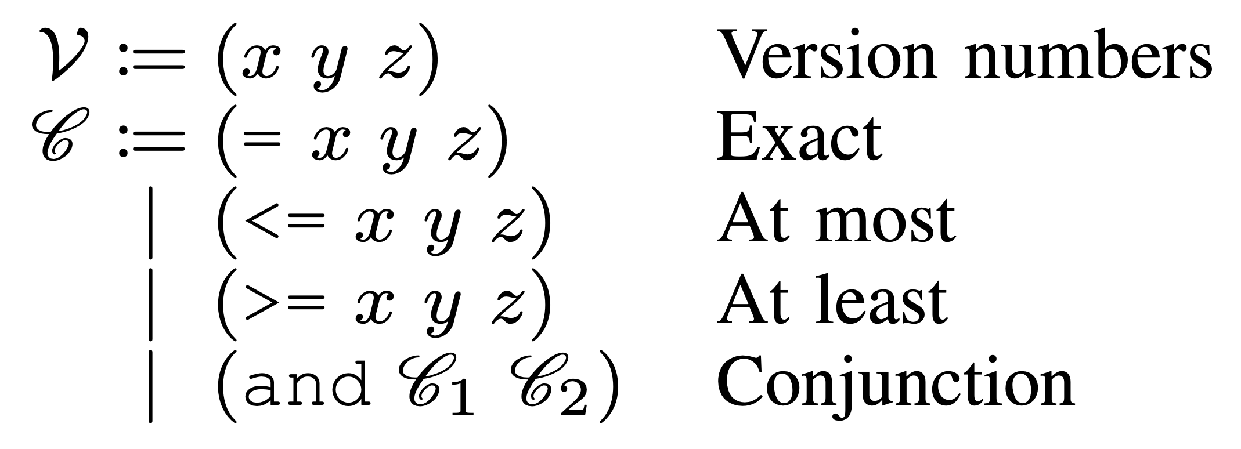
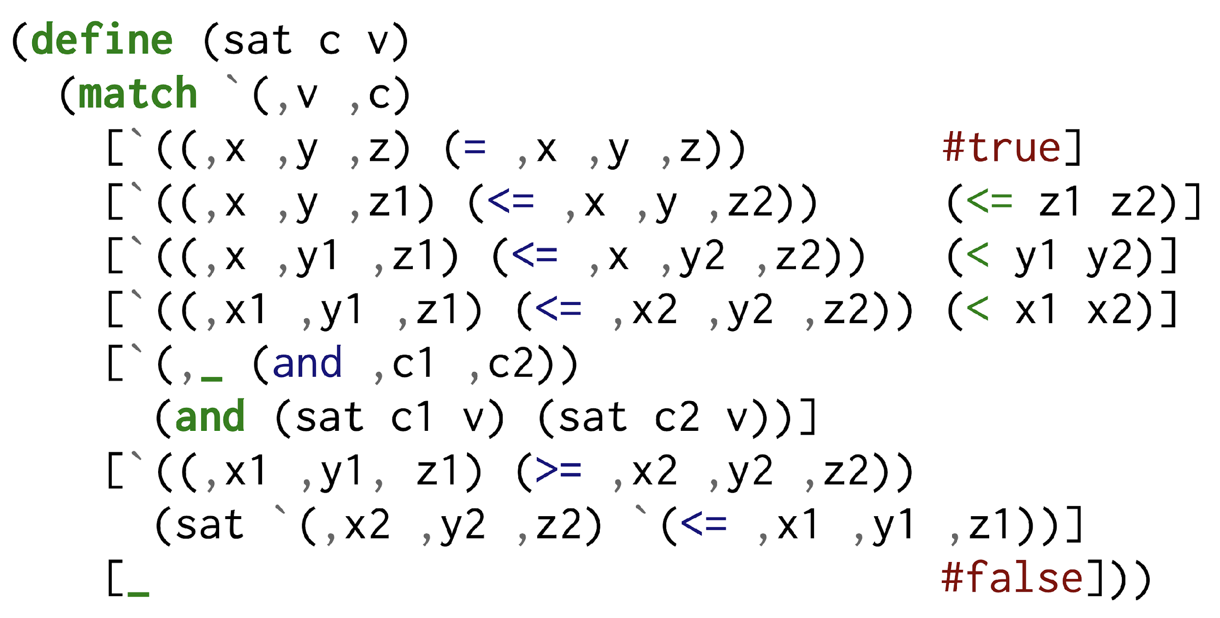
Versions, Constraints, and Constraint Semantics
Does version v satisfy constraint c?
26

Slide 27
Are Multiple Versions of a Package Allowed?
NPM: Yes
PIP: No
Cargo: Partially
...
minimatch v3.2.0
minimatch v3.1.2
27

Slide 28

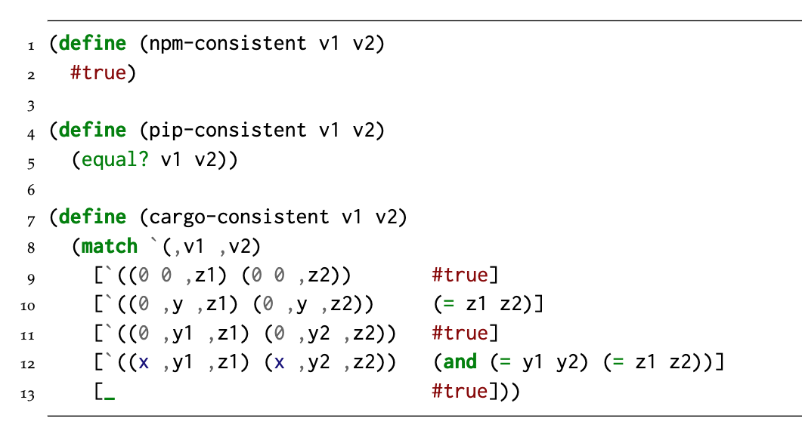
If multiple versions are allowed, which ones are consistent with each other?
Different package managers may allow different combinations
✅
...
❌
✅
minimatch v3.2.0
minimatch v3.1.2
28

Slide 29
If there are many possible solutions, which one should we choose?
"dependencies": {
"commander": "^2.8.1”,
"convert-source-map": "^1.1.0",
"fs-readdir-recursive": "^1.1.0",
"glob": "^7.0.0",
"lodash": "^4.17.10",
"mkdirp": "^0.5.1",
"output-file-sync": "^2.0.0",
"slash": "^2.0.0",
"source-map": "^0.5.0”
}
Smaller
Newer
Not a solution
Duplicate Dependencies
29

Slide 30
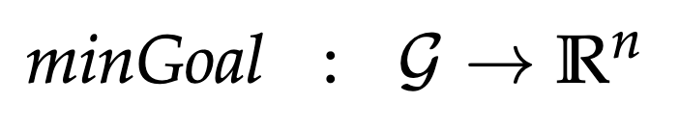
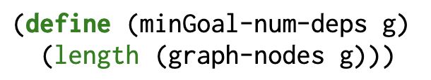
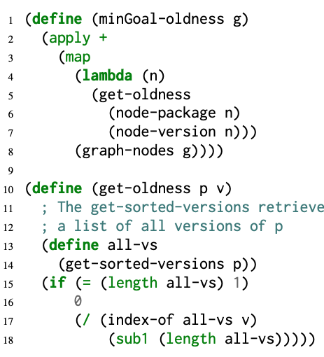
So this is an optimization problem!
Minimize # of Dependencies
Prefer Newer Versions
Different package managers may have different optimization goals
30

Slide 31
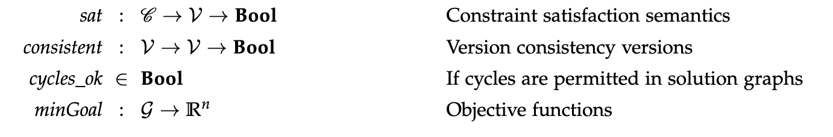
Tunable knobs for a package manager
31

Slide 32
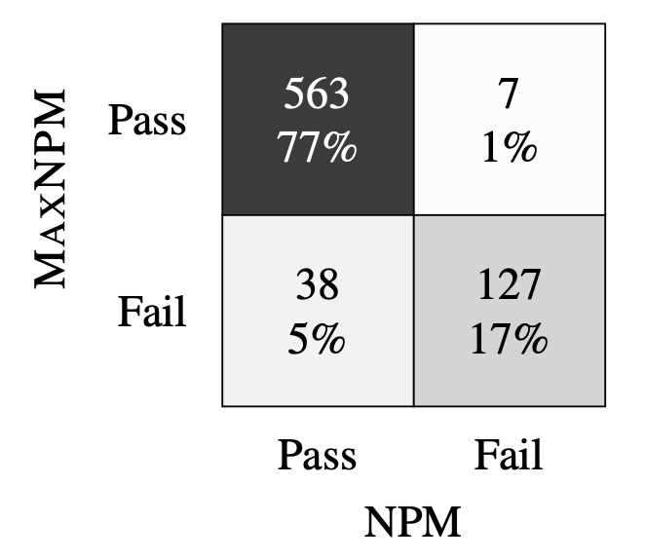
Luckily, most projects are robust to different dependency solutions
32

Slide 33
Learning Objectives for this Module
You should now be able to:
Explain why you need dependencies
Explain the major risks of dependencies
Explain the principles of semantic versioning
Explain what a package manager does
Understand that different package managers may solve dependencies differently

